Slide 1
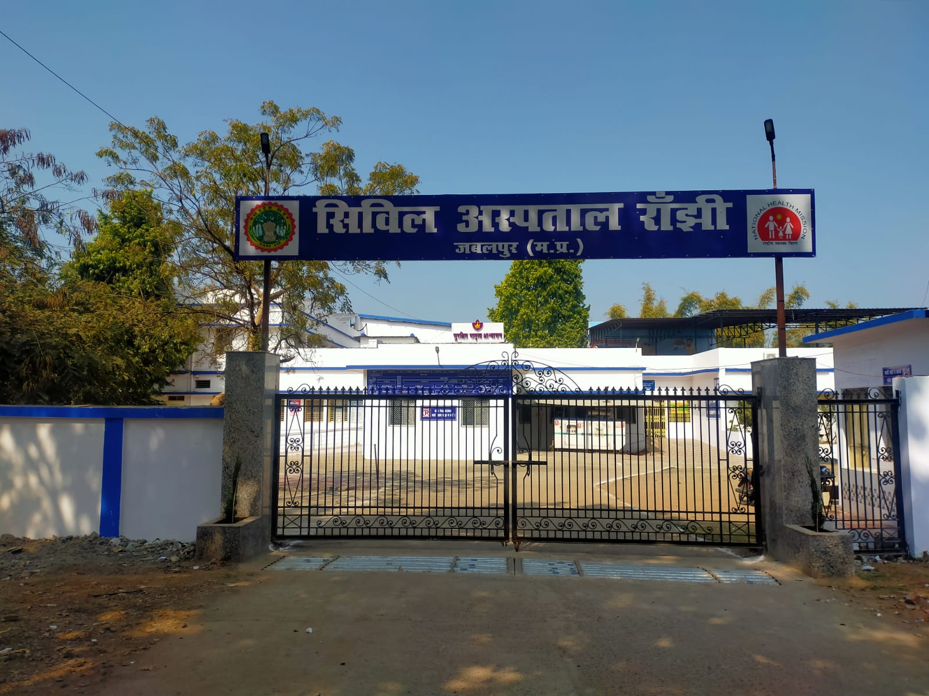
Govt.Civil Hospital Ranjhi,jabalpur
(M.P.)

Slide 2
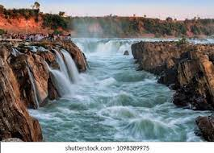
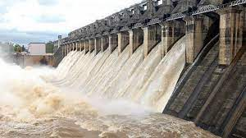
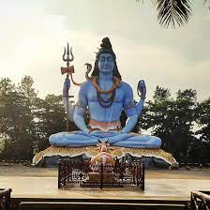
OUR HERITAGE
Jabalpur is a city where tributary of the river Narmada , Bhedaghat Dhuadhar Fall Dhuandhar falls. The waterfall has been named so because of the smok appearance of the water falling off the cliff with utmost force. Bargi Dam is one of the first completed dams out of the chain of 30 major dams to be constructed on Narmada River. Hindu Shiv temple Kachnar City a 23m-tall statue of Lord Shiva at the end of a tree-lined path.

Slide 3
OUR ADMINISTRATIVE OFFICIAL AND STAFF
DM – Mr. Deepak Saxena
RJD & CMHO- Dr. Sanjay Mishra
Facility Incharge – Dr. Sanjay Chhattani
DPM- Shri Vijay Pandey;
DQM – Dr. Shikha Garg

Slide 4
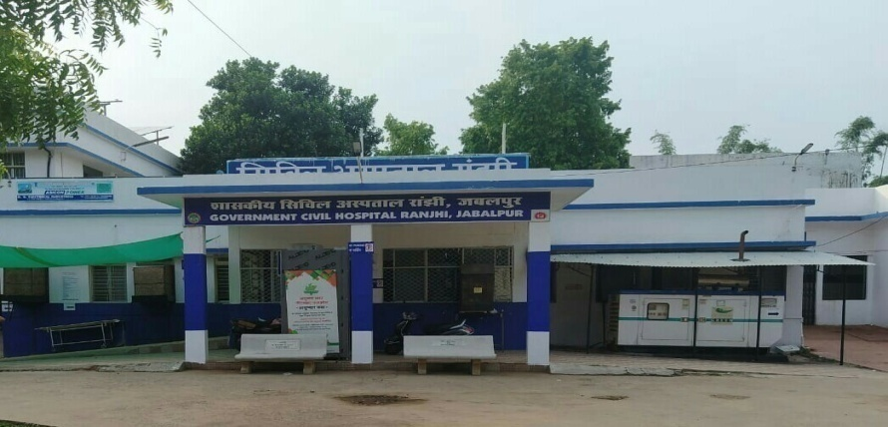
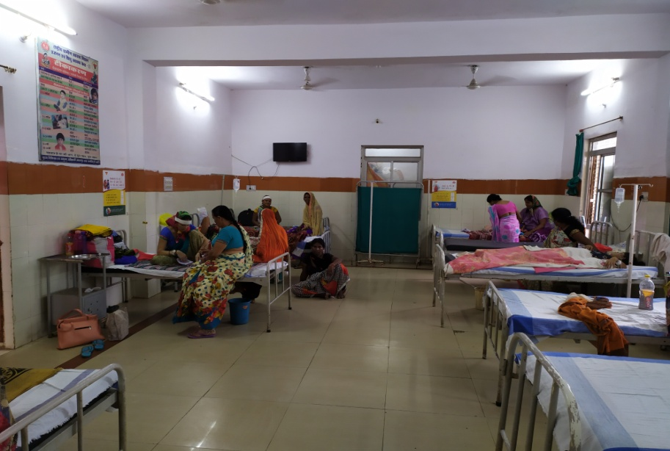
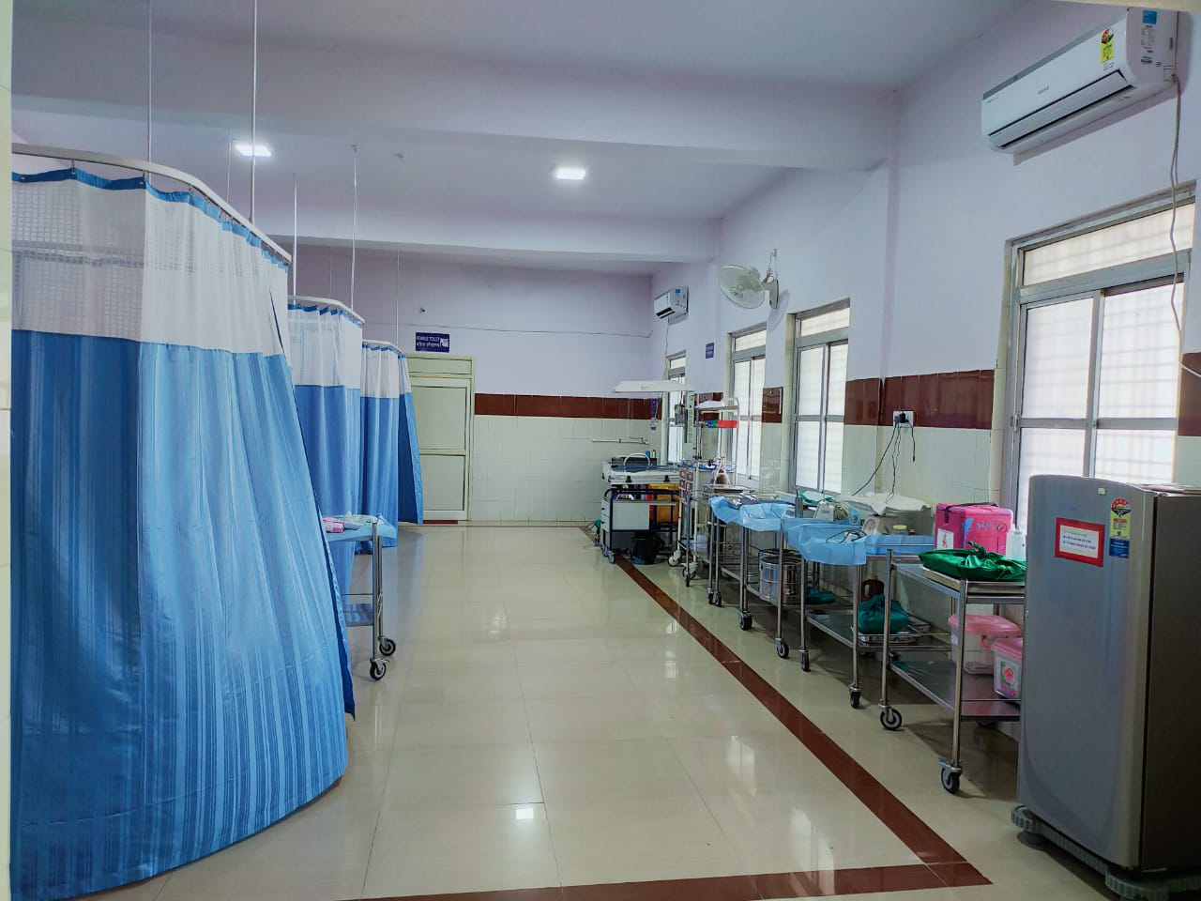
Introduction OF the Hospital
Civil hospital ranjhi is situated in Jabalpur district of Madhya Pradesh. It has bed strength of 20 general patient beds & 10 maternal beds and is functional 24 X 7. It caters to a population of about 121237 with employee strength of around of 80 staff. The centre provides preventive, promotive and curative healthcare services to the community. On an average the civil hospital caters to around 5500 outpatients and 125 inpatients & 30 deliveries per month.
Key services offered by the facility are outpatient, inpatient services including maternity care (normal deliveries & lscs ),central laboratory services (tests for hb, hiv, urine routine/urine culture, malaria, sputum, widal, t3,t4 tsh covid ictc etc.), Family planning services including tubectomy, immunization, pharmacy, referral transport etc.
Name of facility in-charge : Dr. Sanjay Chhattani
Paste Photo of the Hospital and MCH Wing

Slide 5
GEOGRAPHICAL PROFILE OF RANJHI
Geographic Area | Values
Population | 121237 (census 2011)
Health sector | 2
wards | 8
NRC | 1

Slide 6
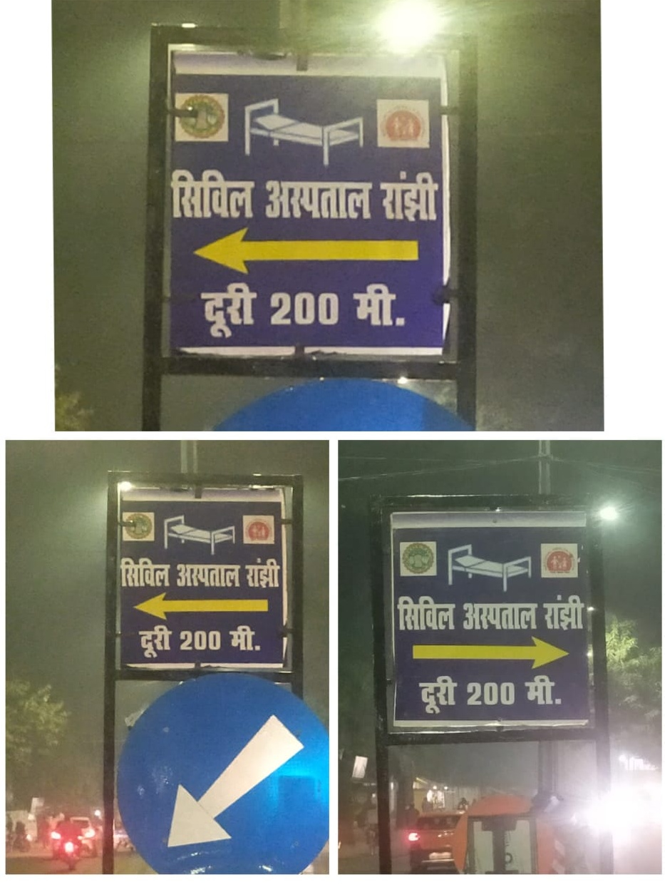
Glow sign board showing distance from main road

Slide 7
CIVL HOSPITAL RANJHI JABALPUR M.P.
MISSION, VISION, QUALITY POLICY AND OBJECTIVE
MISSION
Promoting excellence and continually improving quality of public health services delivering mechanism through innovation that are at par with State and National Health Policy
VISION
A society where all people live healthy, live long with peace of mind knowing all their healthcare needs will be delivered by State public health system.
QUALITY POLICY
We are committed to provide high quality healthcare services to the people in district with sustainable efforts to ensure that it is equitable, accountable, ethical and delivered in dignified manner with continuous improvement shall be the guiding principle of all endeavours.

Slide 8
Quality objectives
To inculcate an excellent infection control methods in hospital.
To improve patient satisfaction by monitoring and measuring the accessible facilities.
To focus on providing best quality services.
To improve the efficiency and protect patients.
To protect and secure all patients rights and safety.
To involve all employees in providing best quality service to patients.

Slide 9
Services available

Slide 10
Departments with room numbers

Slide 11
Citizen charter displayed at hospital enterance

Slide 12
NAME OF DOCTORS WITH DESIGNATION

Slide 13
HR INFORMATION
S.No | Post | SANCTION | Regular | Contractual
1 | GYNAECOLOGY | 1 | 1 | 0
2 | ANAESTHETICS | 1 | 1 | 0
3 | MEDICAL OFFICER | 5 | 4 | 0
4 | DENTIST | 1 | 2 | 0
5 | SENIOR NURSINGH OFFICER | 1 | 1 | 0
6 | NURSING OFFICER | 15 | 25 | 2
7 | PHARMACIST | 2 | 1 | 1
8 | LAB TECHNICIAN | 2 | 2 | 2
9 | RADIOGRAPHER | 1 | 1 | 0
10 | OPTHALMIC ASSISTANT | 1 | 1 | 0
11 | STORE KEEPER | 1 | 1 | 0
12 | ACCOUNTANT | 1 | 1 | 0
13 | DRESSORE | 1 | 1 | 0
14 | MPW | 0 | 1 | 0
15 | FEEDING DEMONSTRATOR | 1 | 0 | 1
17 | COUNSELLOR ICTC | 1 | 0 | 1
18 | OT ATTENDENT | 1 | 1 | 0
19 | ANM | 1 | 1 | 1
20 | TBHV | 1 | 0 | 1
21 | DATA ENTRY OPERATOR | 2 | 0 | 2

Slide 14
HR INFORMATION
S.No | Post | SANCTION | Regular | Contractual
1 | DDC SUPPORT STAFF | 1 | 0 | 1
2 | SAFAI KARMCHARI | 2 | 2 | 0
3 | WARD BOY | 4 | 5 | 0
4 | SUPPORT STAFF NRC | 4 | 0 | 4
5 | OUTSOURCE | 8 | 0 | 8
6 | SECURITY GUARD (OURTSOURCE) | 4 | 0 | 4
7 | RKS / OUTSOURCE |  |  | 2

Slide 15
24X7 BED AVAILABILITY
S.No. | Name of Department | No. of beds
1 | Labor Room | 3
2 | ANC & PNC | 9 +1 (Eclampsia bed)
3 | Septic Delivery Room | 1
4 | General ward | 10
5 | NRC | 10

Slide 16
HOSPITAL ENTARANCE GATE

Slide 17
Solar panel present at roof top

Slide 18
Shade donates at registration center by mla cantt mr ashok rohani

Slide 19
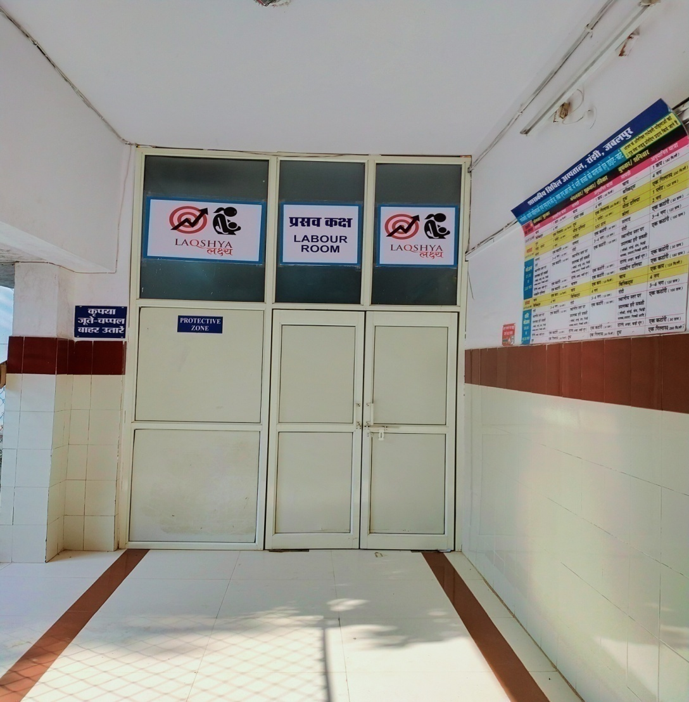
MATERNITY WING

Slide 20
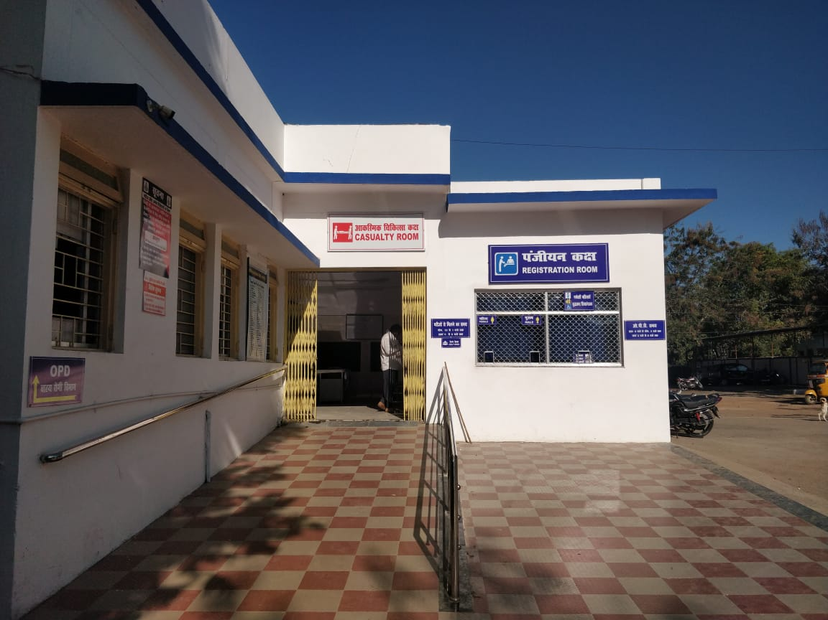
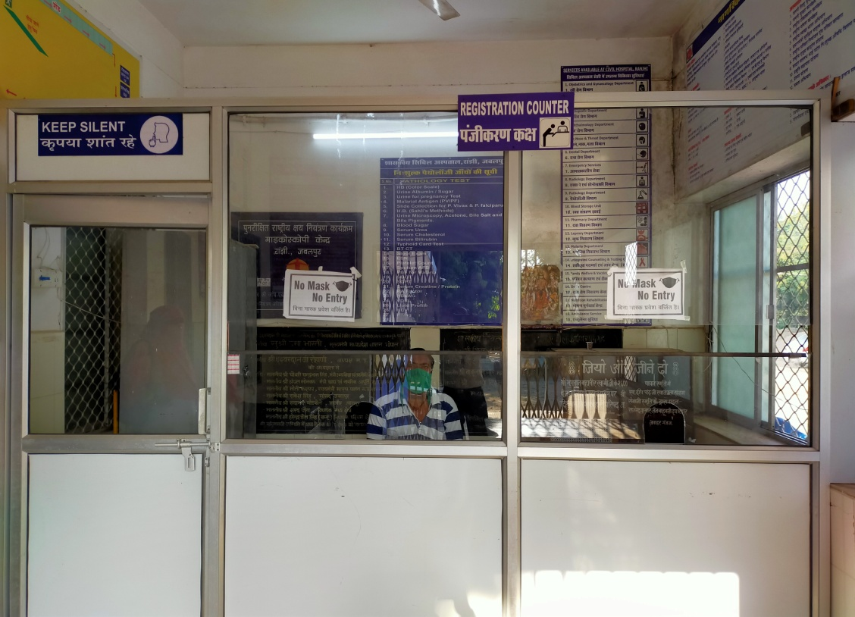
Patients Registration Counter Before & After

Slide 21
CATTLE GUARD
CATTLE GUARD INSTALLED AT MAIN ENTERENCE OF THE HOSPITAL

Slide 22
Surveillance sYSTEM

Slide 23
CLEANING WATER HEAD TANKS

Slide 24
BMW Meeting Civil Hospital Ranjhi

Slide 25
Hand Wash Training

Slide 26
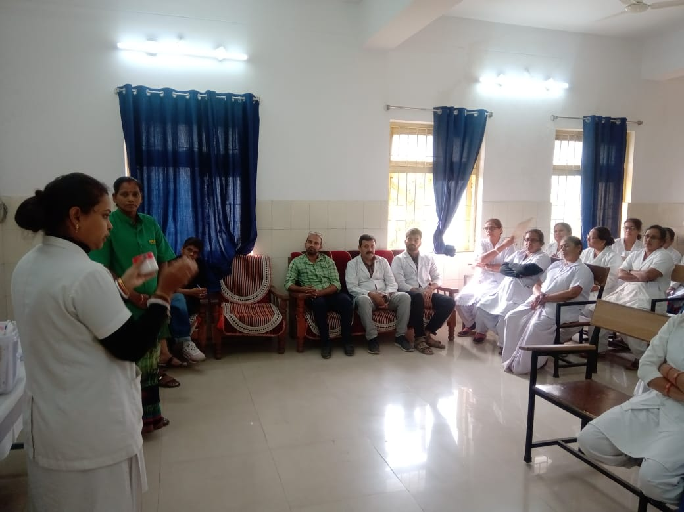
5 S Meeting

Slide 27
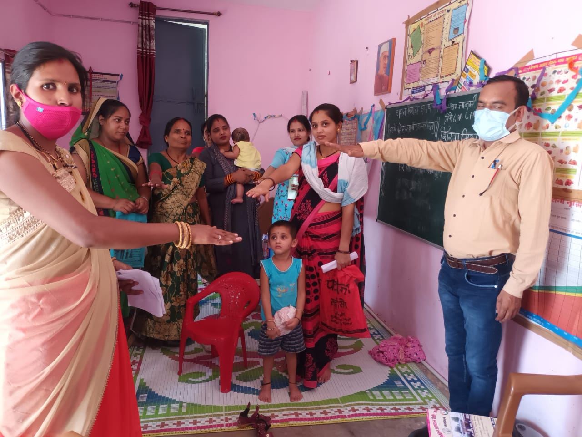
School And Anganwadi Visit Promoting Hygeine and Sanitation

Slide 28
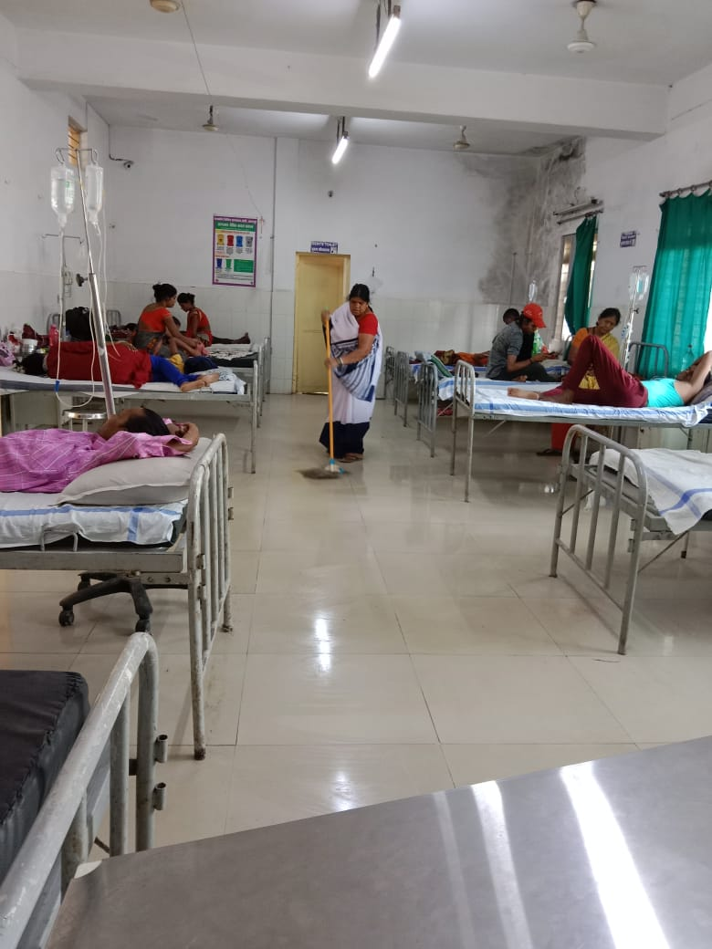
Cleaning of Wards Three Times a Day

Slide 29
FIRE EXTINGUISHER TRAINING

Slide 30
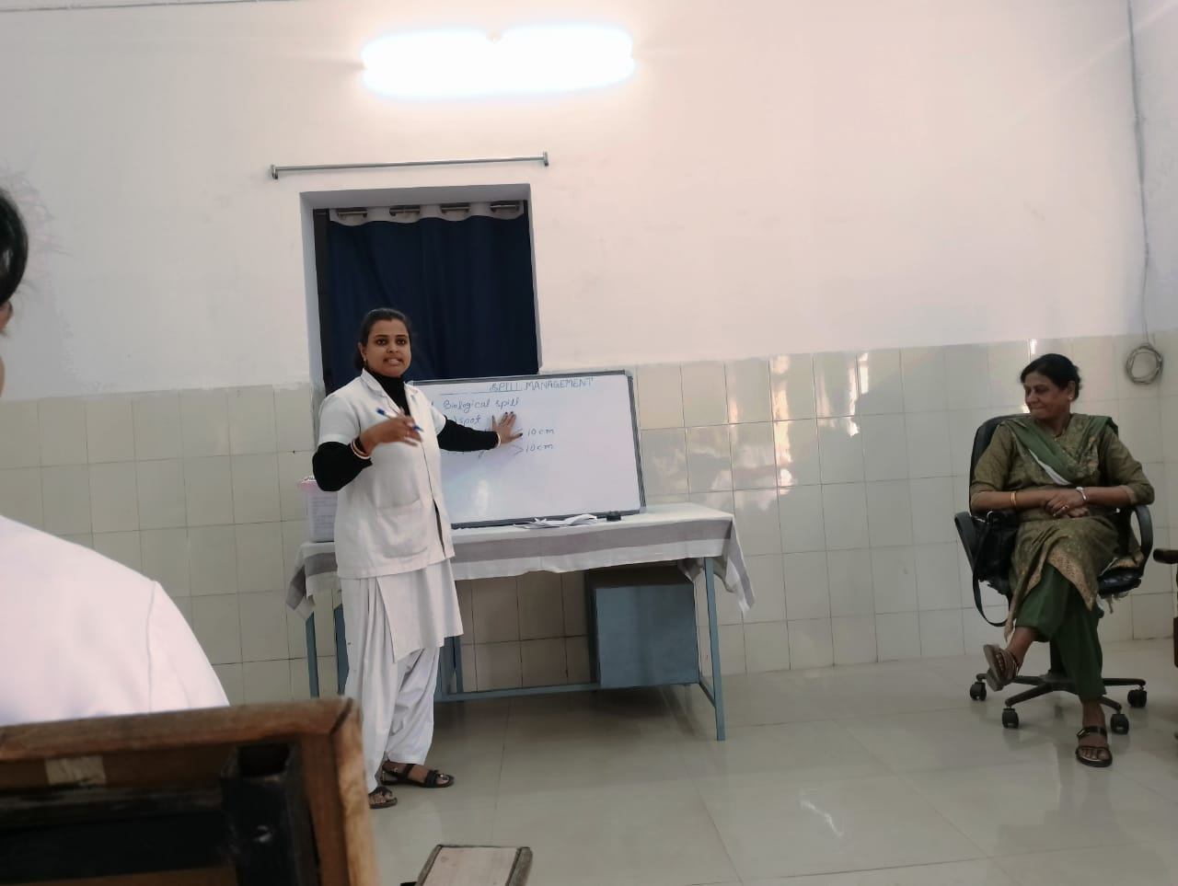
SPILL MANAGEMENT TRAINING

Slide 31
3 BUCKET AND MOPPING TRAINING

Slide 32
BIO MEDICAL WASTE MANAGEMENT

Slide 33
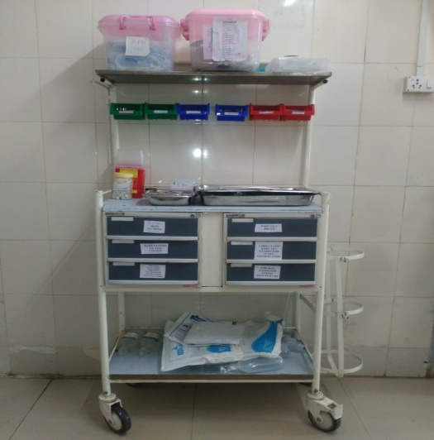
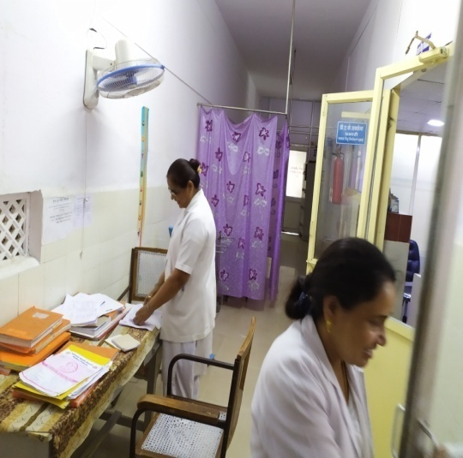
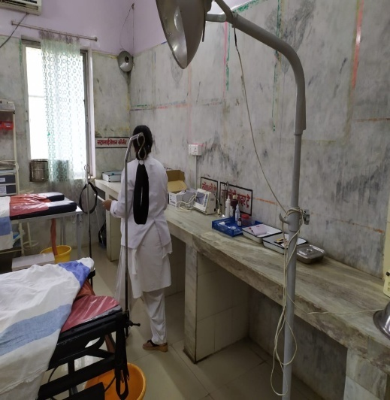
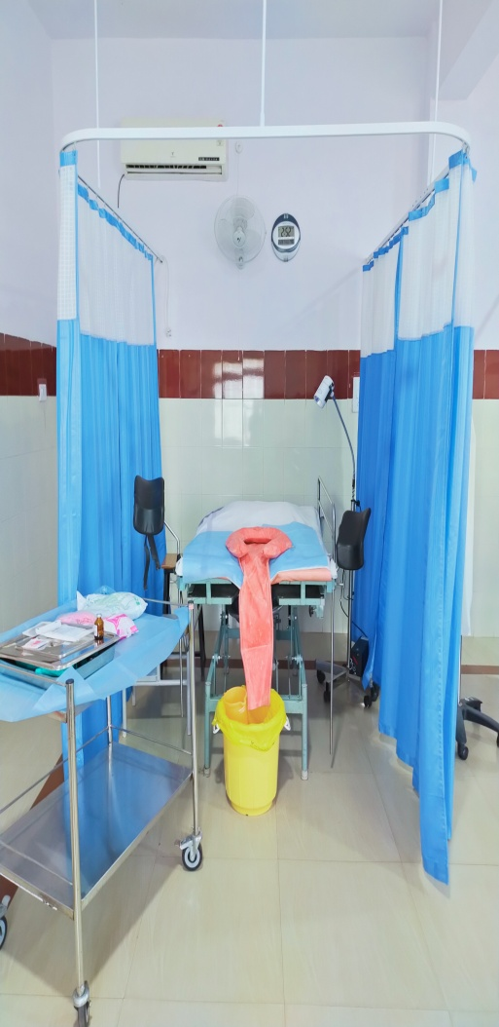
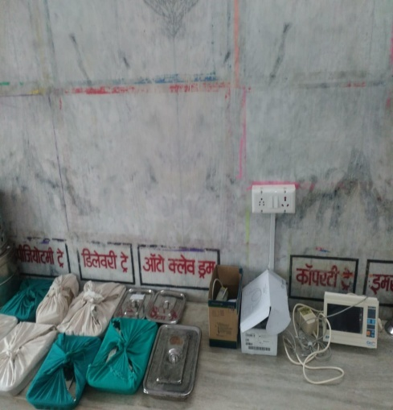
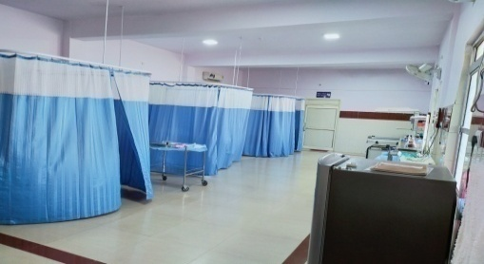
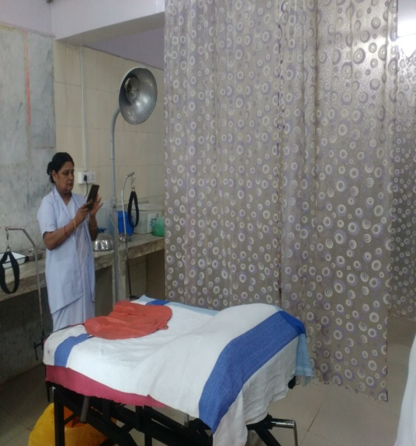
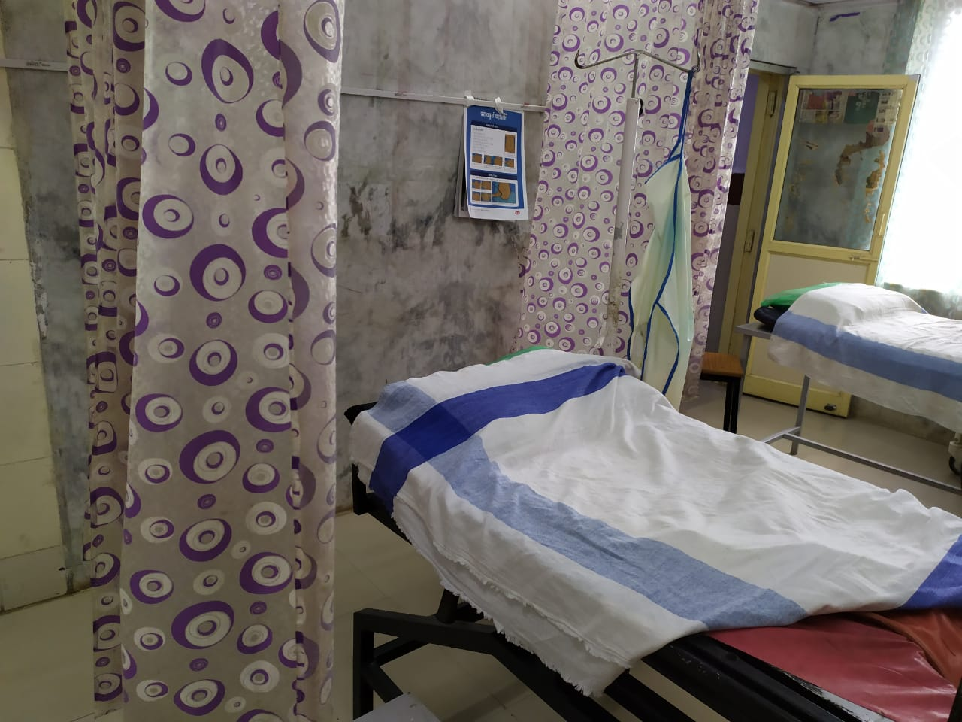
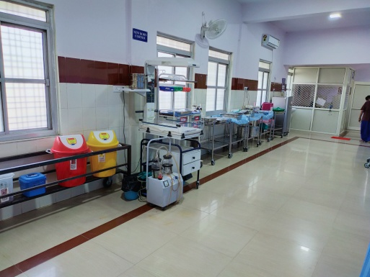
Glimpses of Labour Room Before After
Before implementation of Laqshya (Labour room)
After implementation of Laqshya (Labour room)

Slide 34
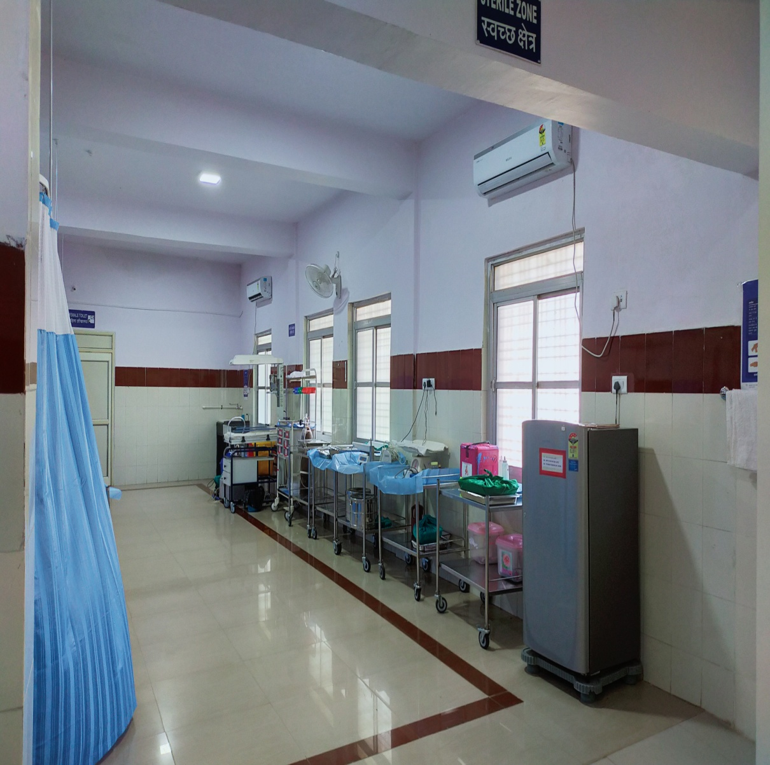
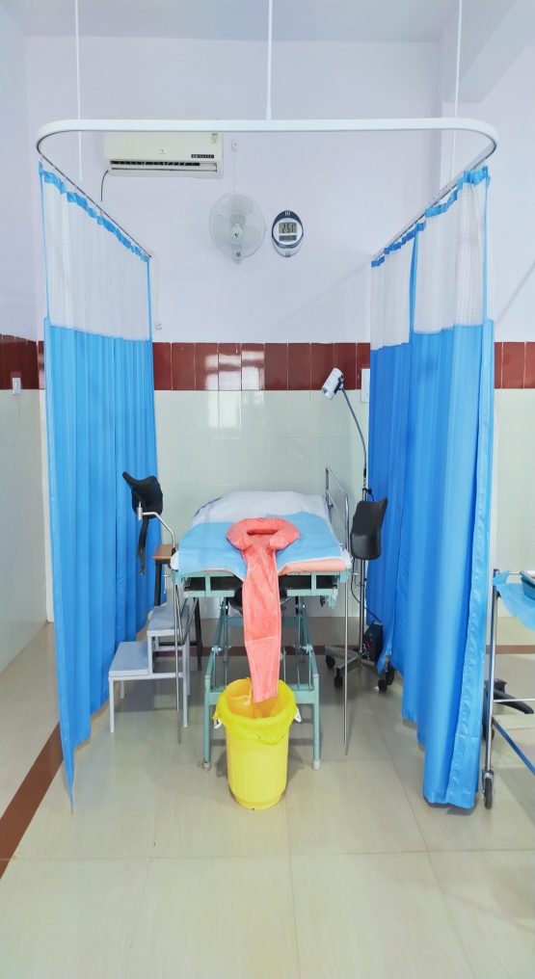
Glimpses of Labour room

Slide 35
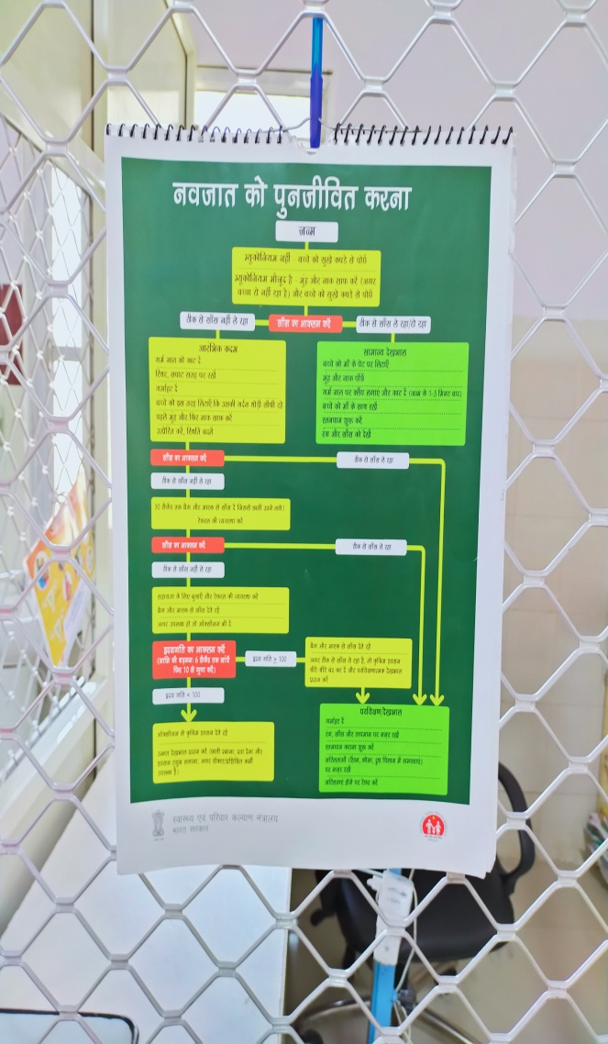
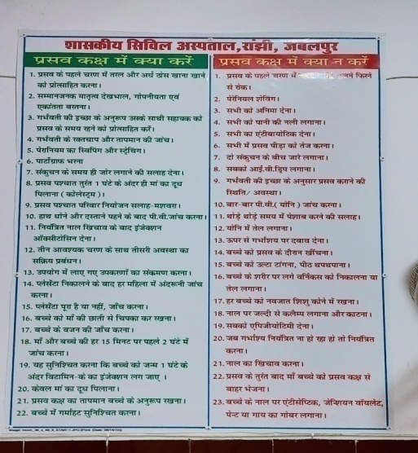
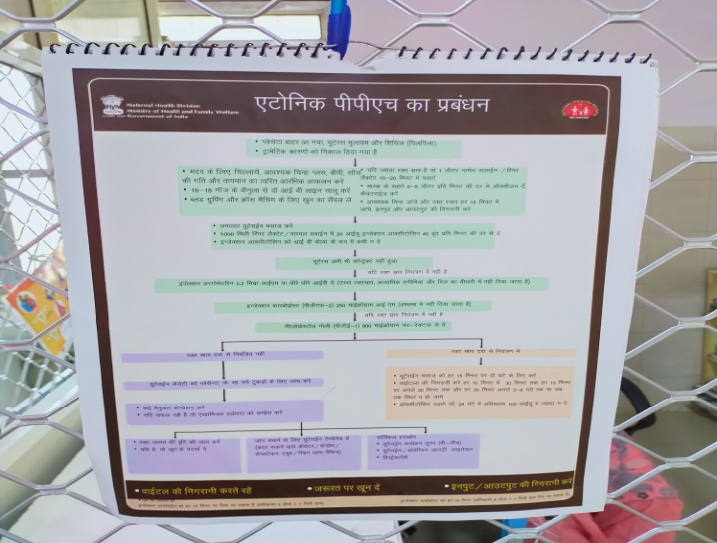
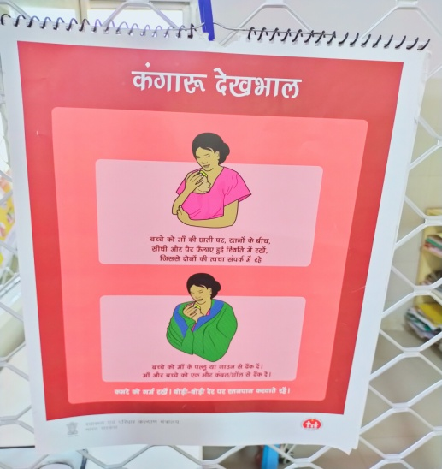
Instruction In LR

Slide 36
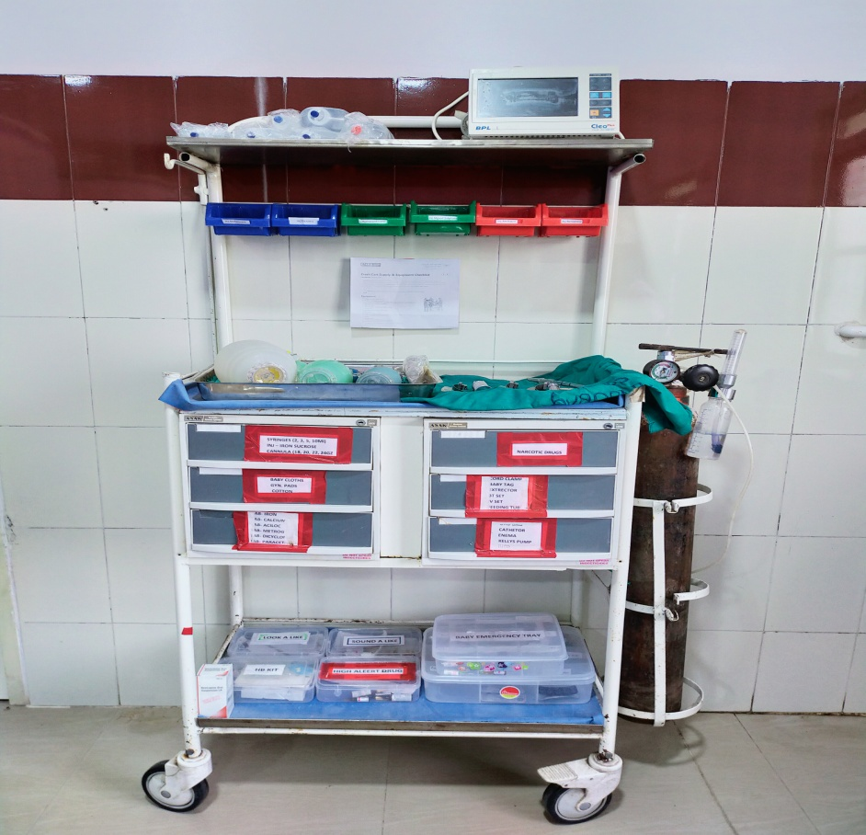
Emergency Trolly & Medicine Tray

Slide 37
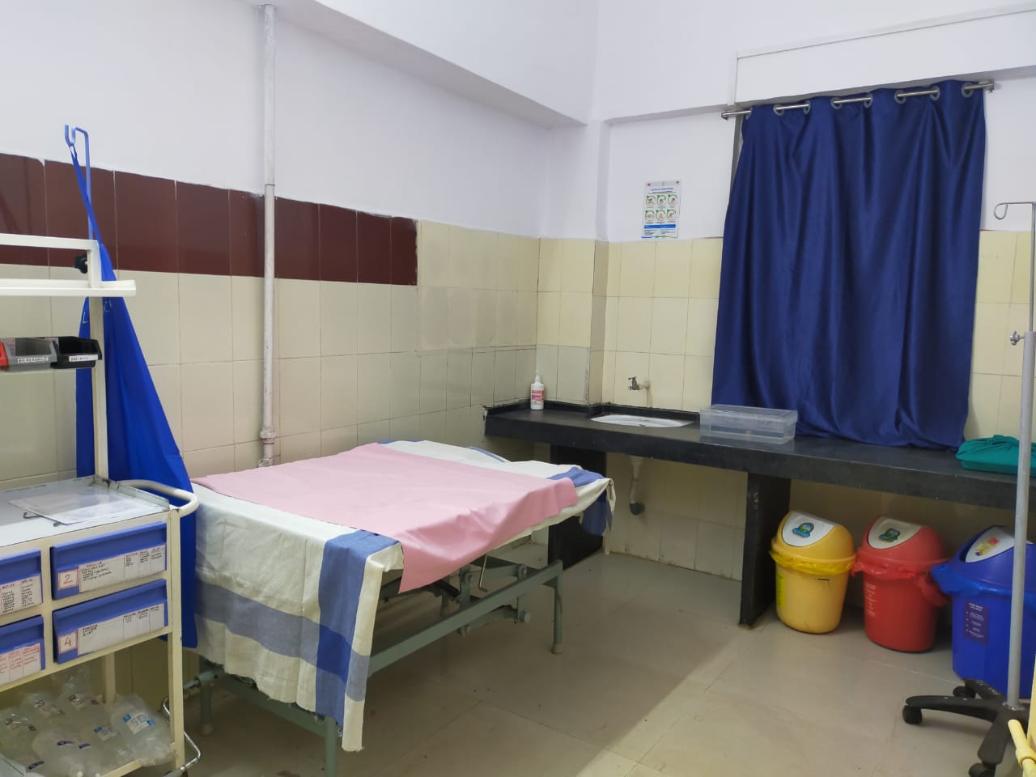
SEPTIC DELIVERY ROOM

Slide 38
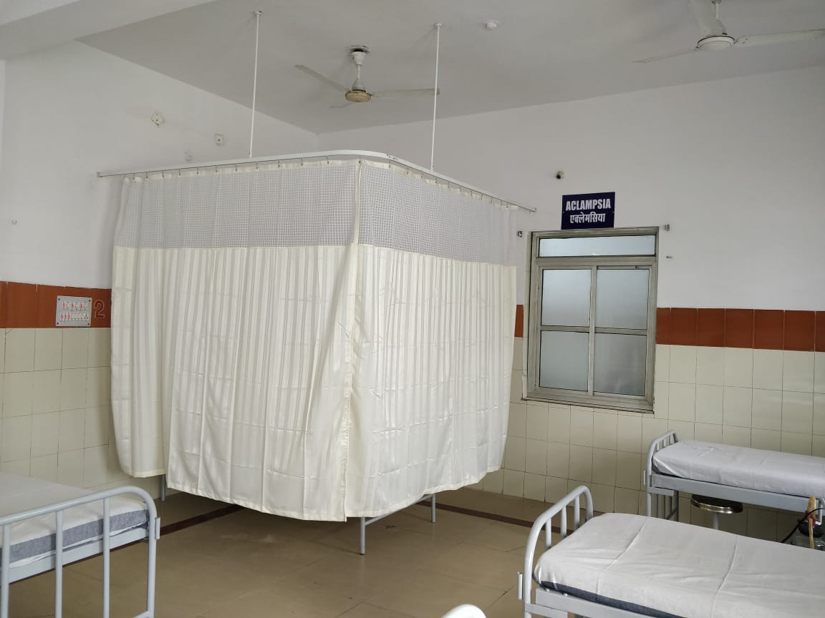
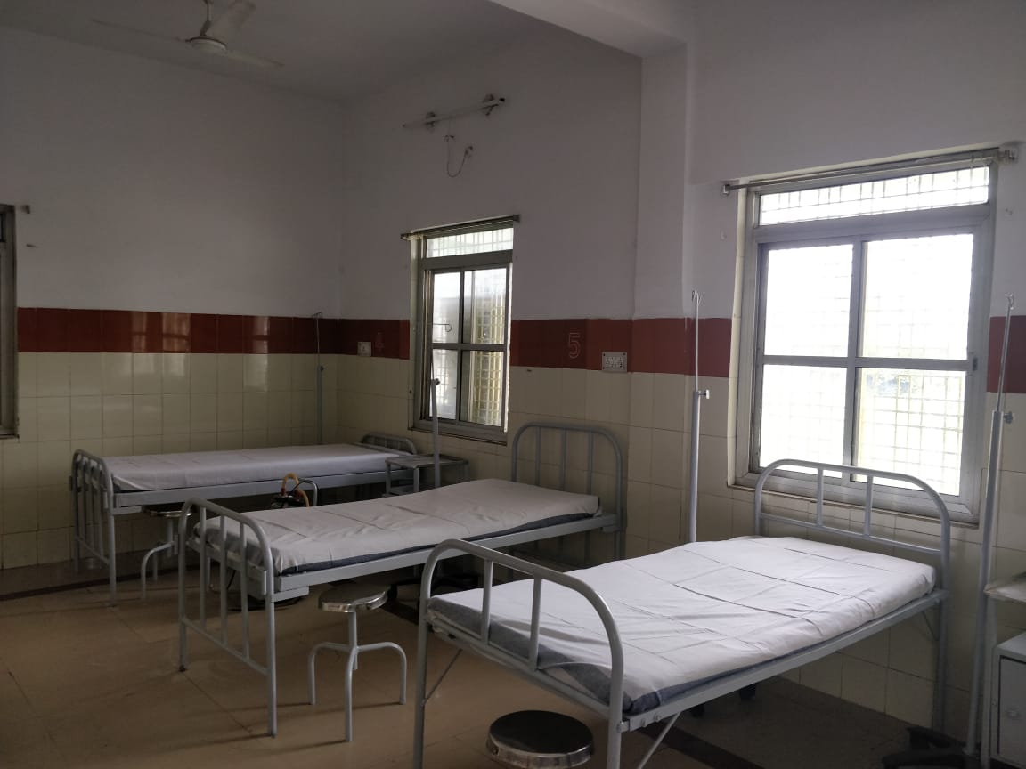
ECLAMPSIA BED & ANC WARD

Slide 39
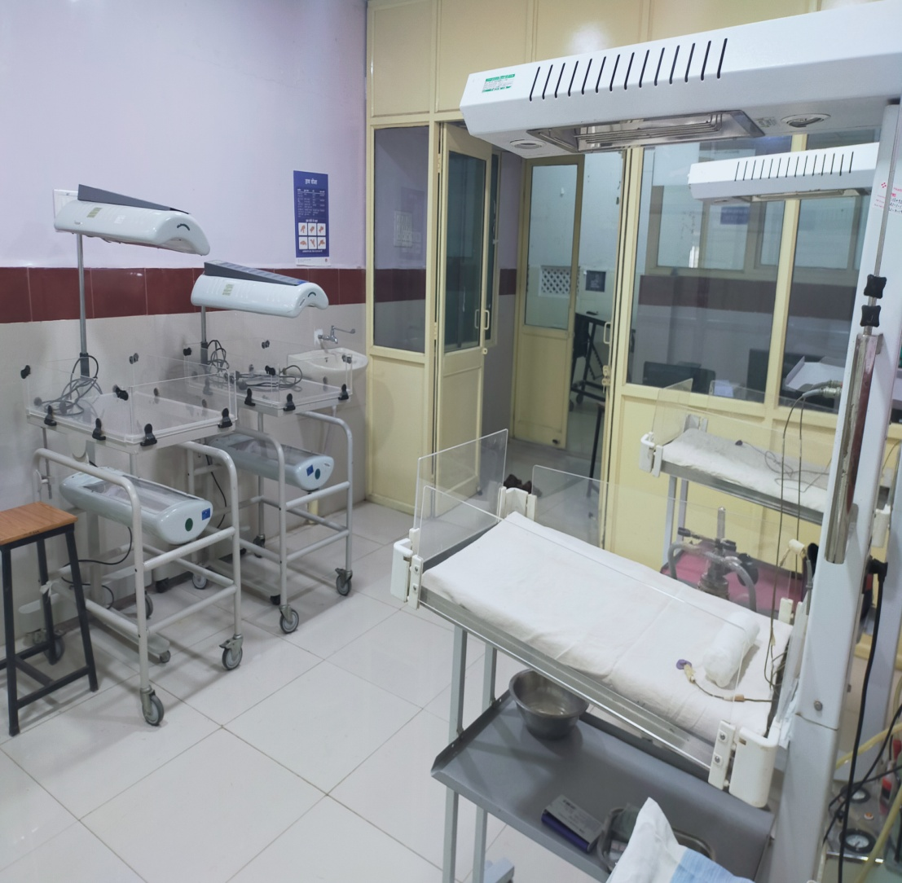
New Born Care Area

Slide 40
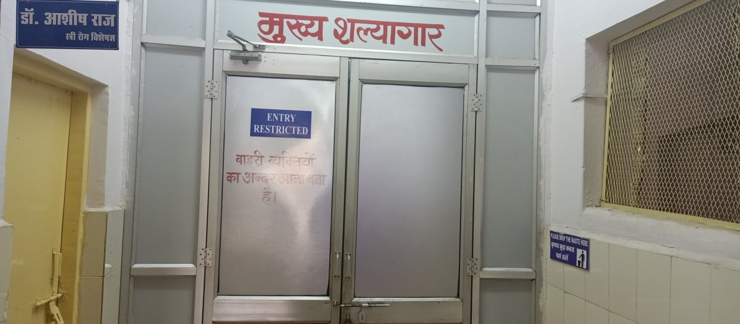
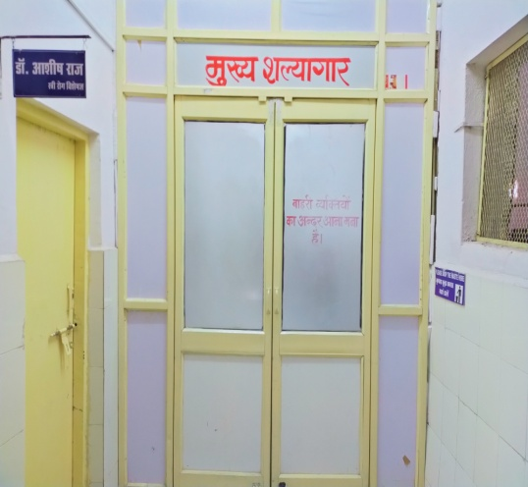
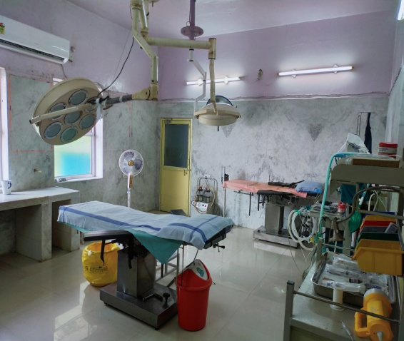
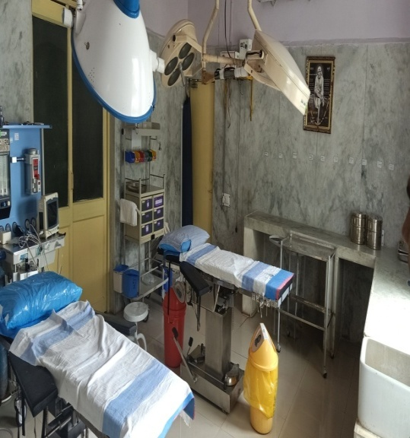
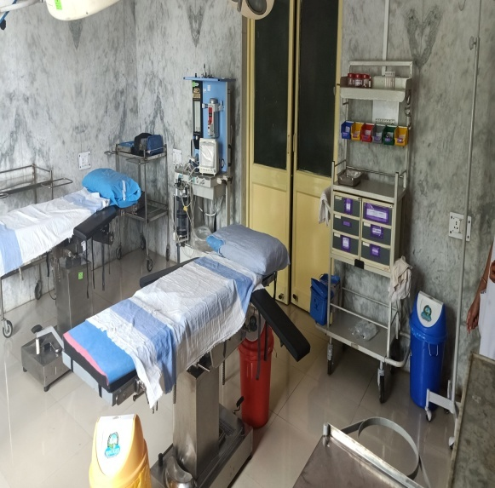
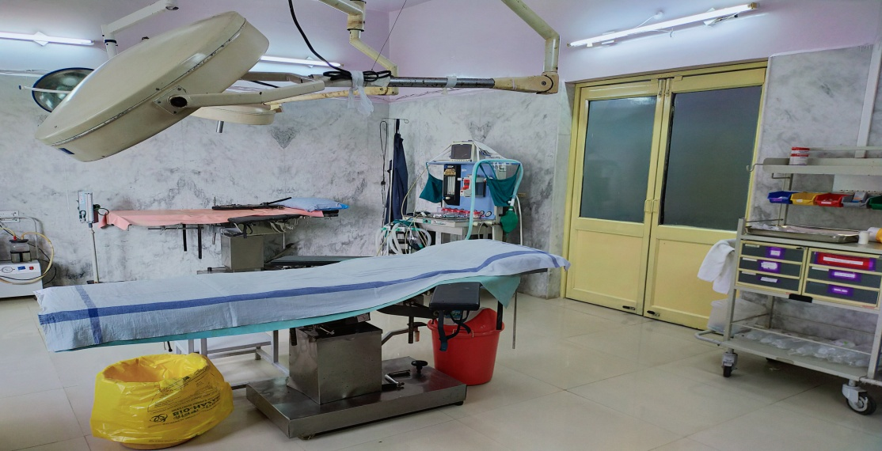
Glimpses of ot ( Before and After )
Before implementation of Laqshya (Labour room)
After implementation of Laqshya (Labour room)

Slide 41
Maternity operation theatre

Slide 42
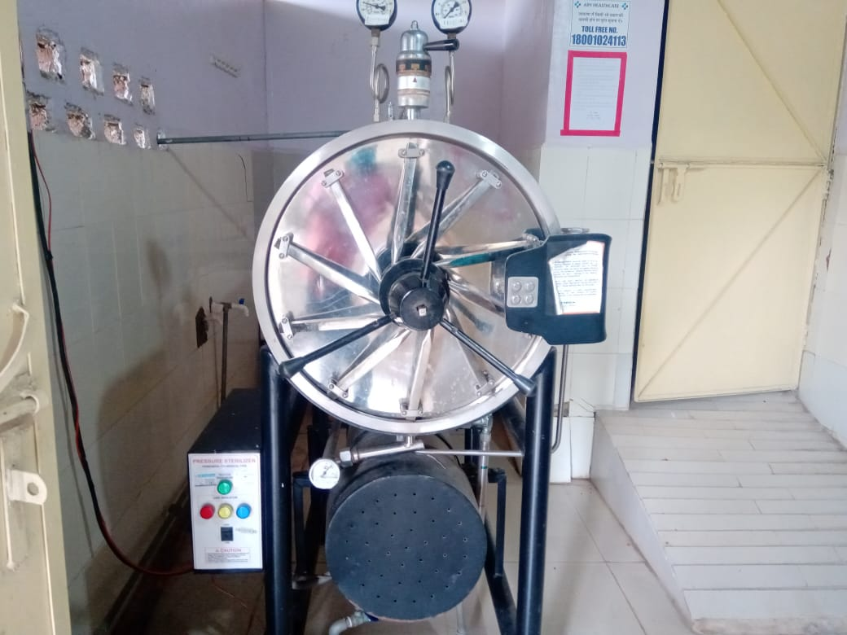
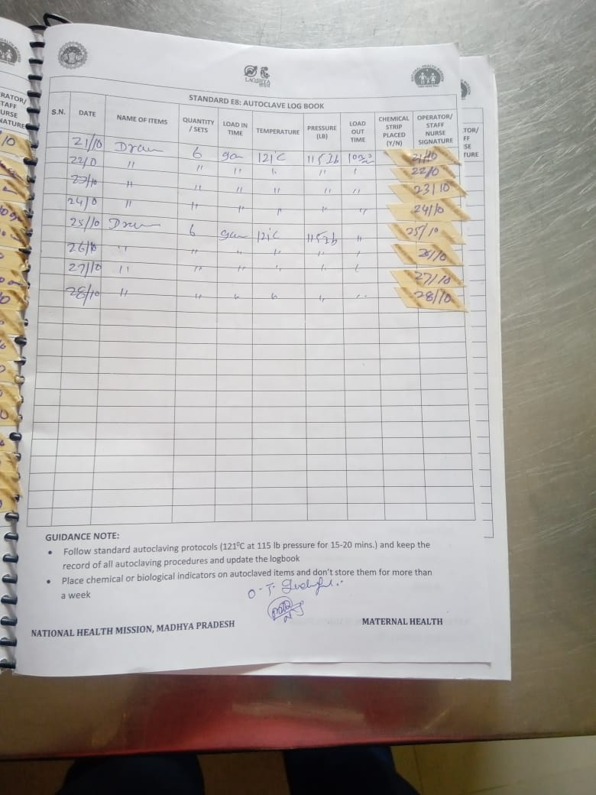
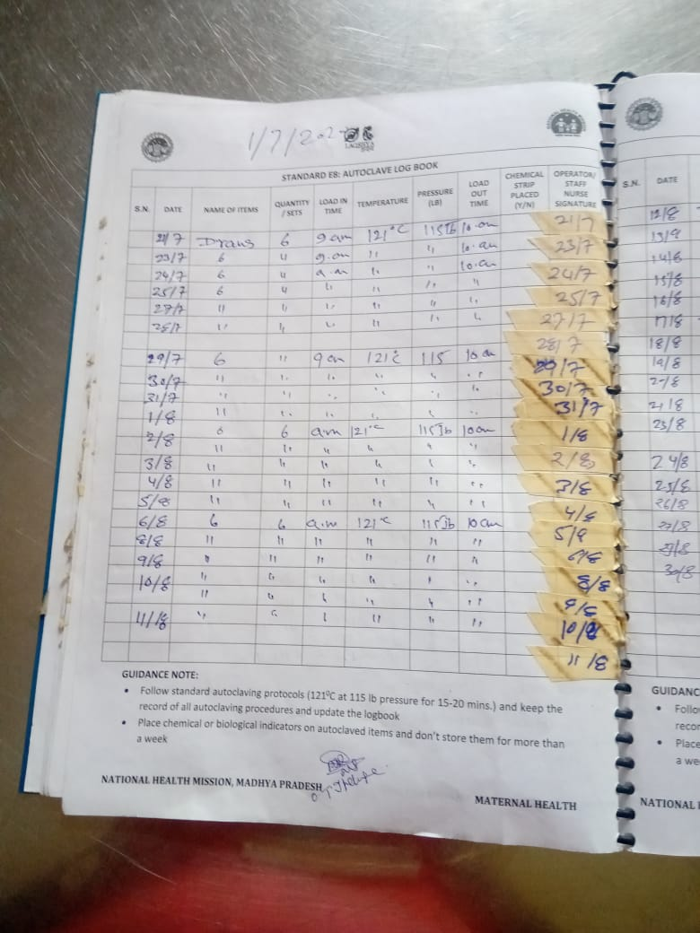
Sterilization Unit

Slide 43
Three Bucket Mopping

Slide 44
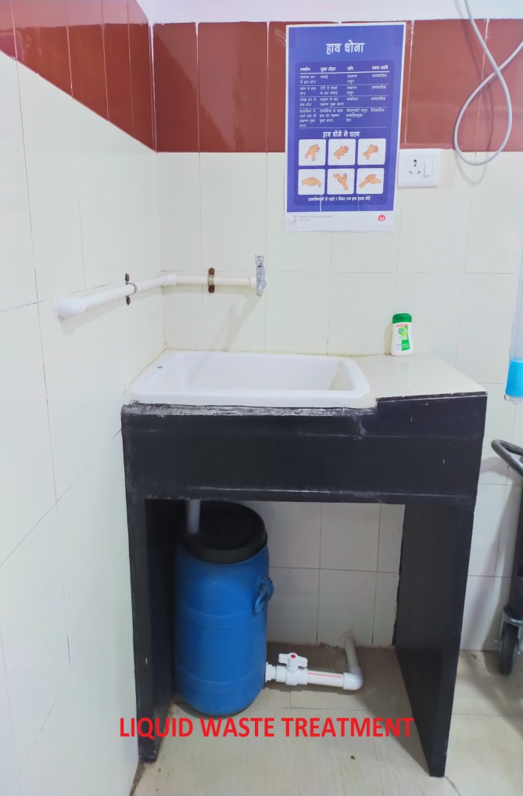
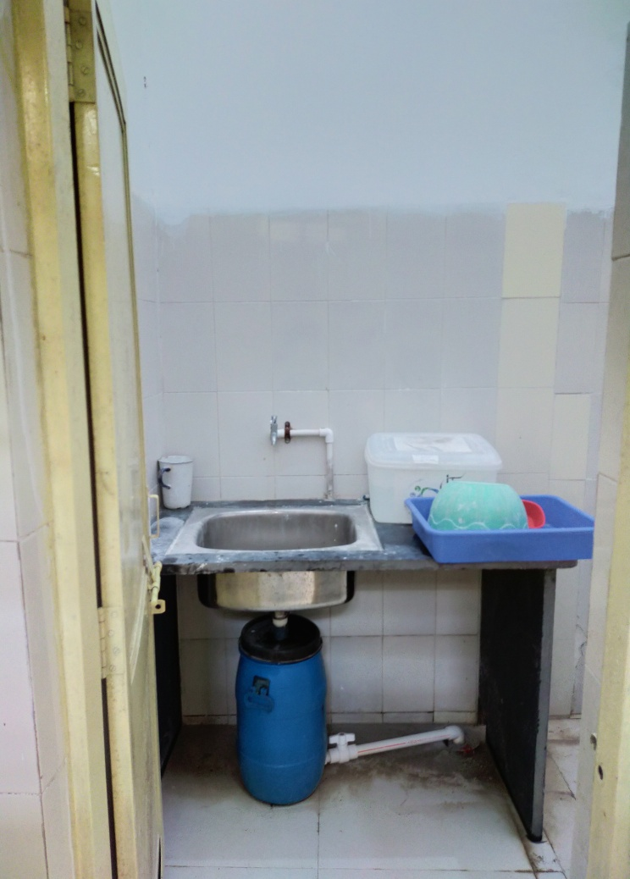
Liquid Waste Management

Slide 45
Storage Facility of Biomedical Waste

Slide 46
Bio Medical Waste

Slide 47
INFRASTRUCTURE MAINTANENCE

Slide 48
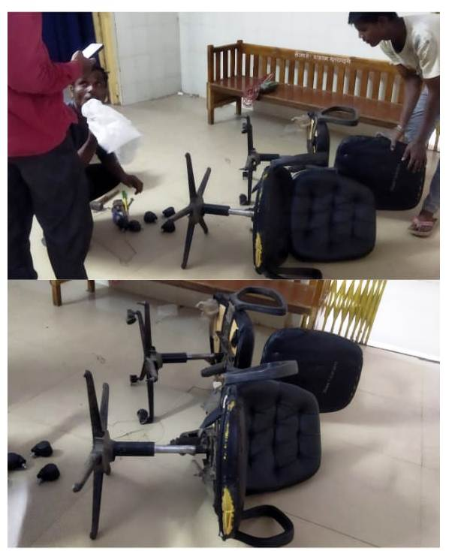
FURNITURE MAINTENANCE

Slide 49
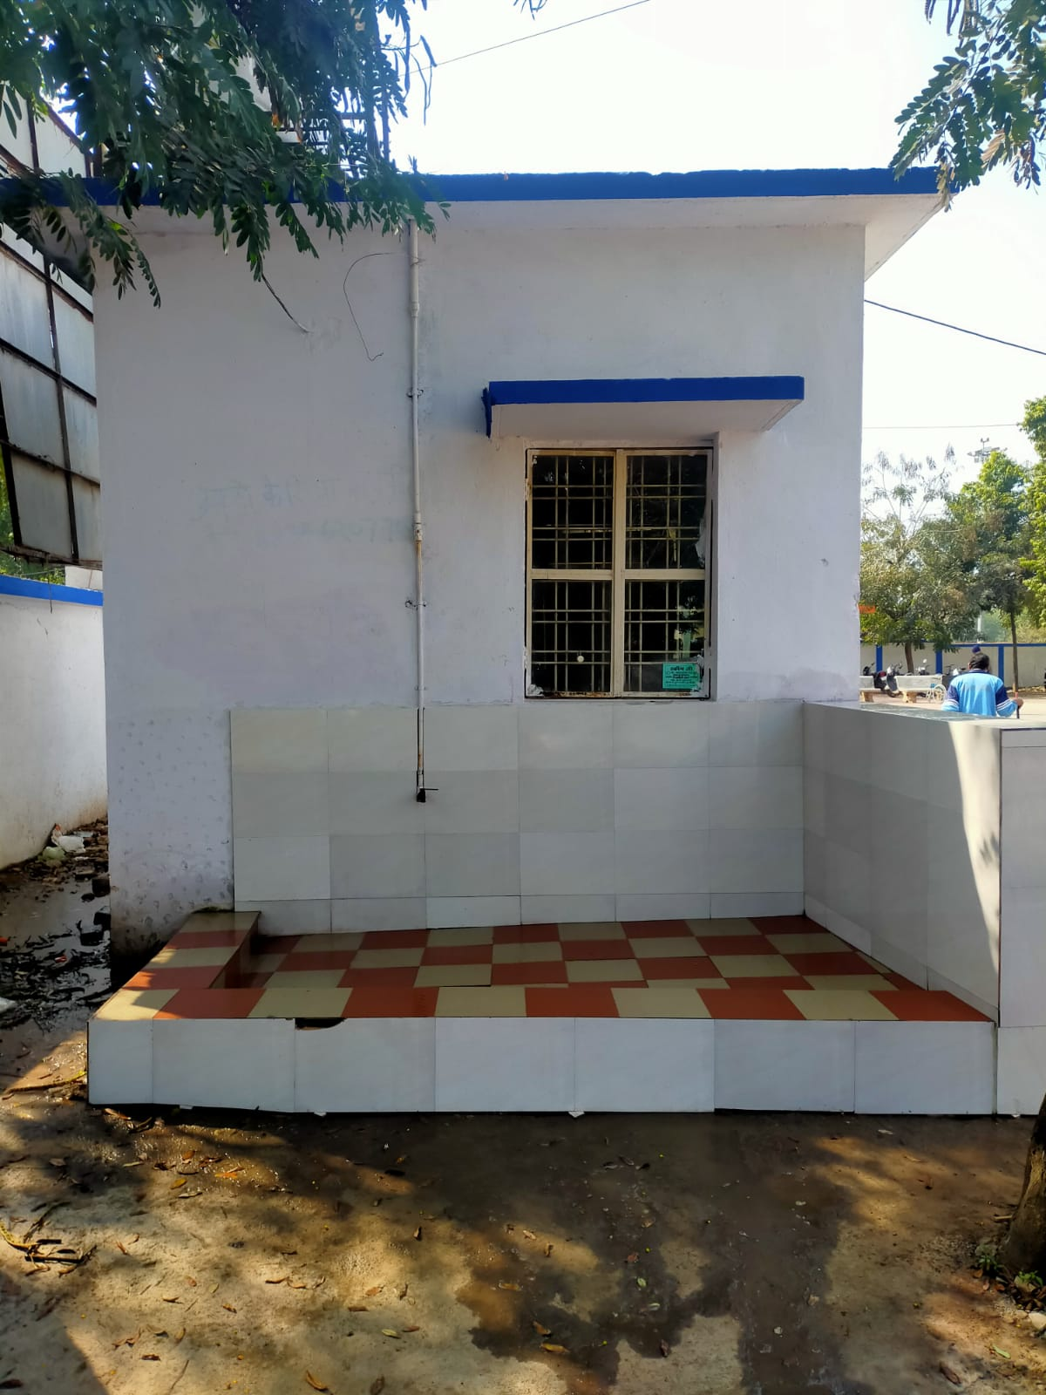
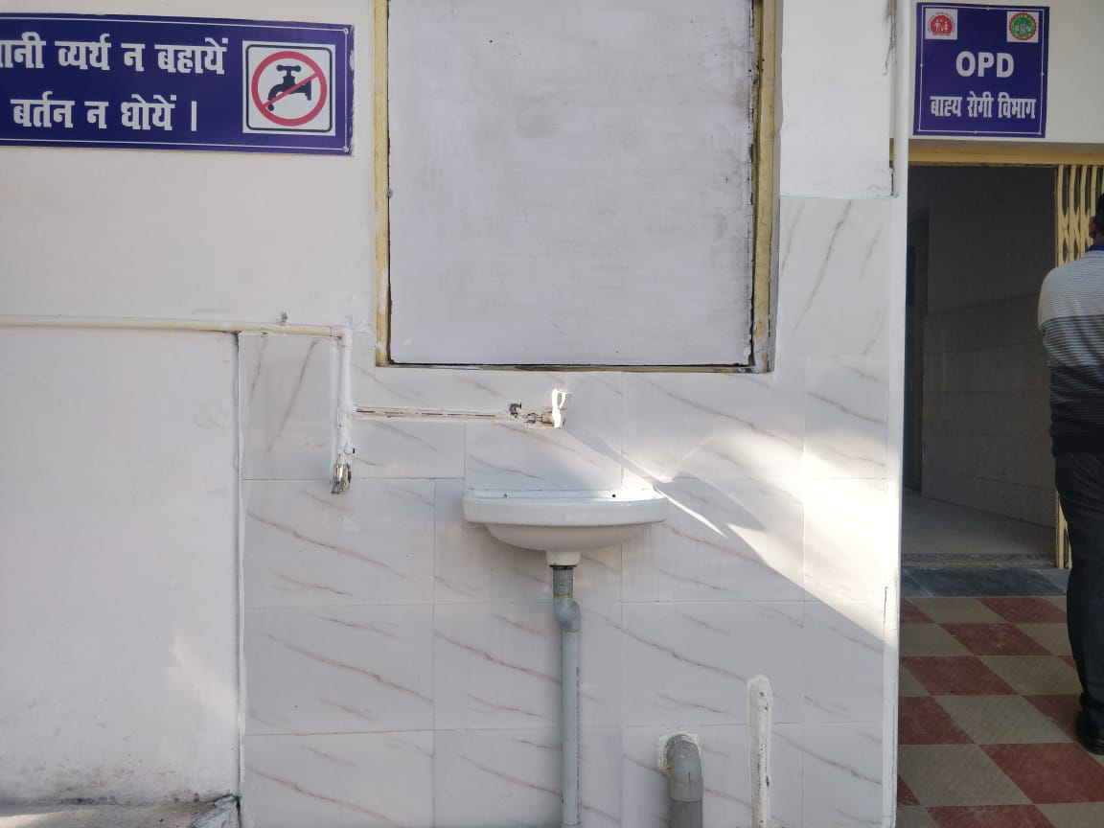
PUBLIC UTILITY FACILITY

Slide 50
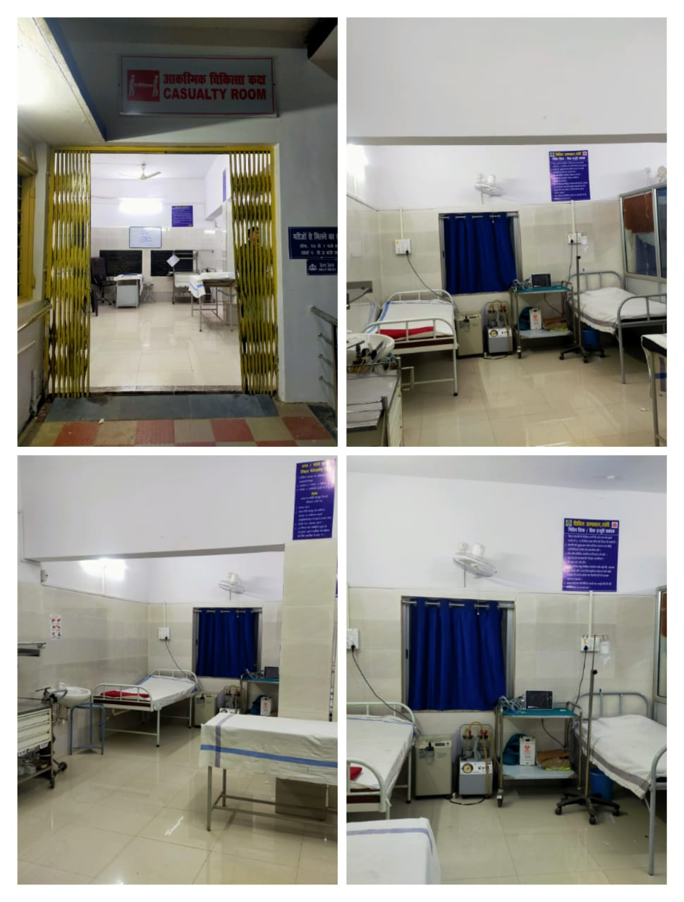
GLIMPSES OF NEW CASUALTY AREA

Slide 51
GLIMPSES OF FOUNTAIN

Slide 52
GLIMPSES OF WASHROOM

Slide 53
HOSPITAL MAINTANENCE

Slide 54
PARKING AREA

Slide 55
LANDSKAPING AND GARDENING BEFORE AFTER

Slide 56
COMPOST PIT

Slide 57
ECO-FRIENDLY INDOOR GAMES

Slide 58
R.O. installation & MAINTENANCE

Slide 59
MEMBER OF RKS COMMITTEE VISITED IN HOSPITAL

Slide 60
LAUNDRY & LINEN SERVISES

Slide 61
QUALITY CIRCLE COMMITEE

Slide 62
Infection control committee

Slide 63
Disaster managemet committee

Slide 64
Bio medical waste management committee

Slide 65
PRESCRIPTION AUDIT COMMITTEE

Slide 67
Thanks

